Slide 1
Emergency PREPAREDNESS Check-up
ANN HEPENSTAL
COMMUNITY EMERGENCY PREPAREDNESS COORDINATOR
ahepenstal@losaltosca.gov
November 13, 2021

Slide 2
Agenda
Quick overview: preparedness basics!
Family preparedness
Emergency notifications and alerts
Evacuations
AlertSCC!
Zonehaven!
Preparedness check-up

Slide 3
Preparedness Basics
Earthquakes
Fire/Wildfire
Flood
Other Natural disasters
Take an “All Hazards” approach!
Register for emergency notifications
Know what to do
Get trained on basic first aid skills
Drop, Cover, Hold On
Evacuation warnings/orders
Know where to get reliable information
Know your evacuation routes
2 ways out of your home
2 ways out of your neighborhood
Define an emergency communications plan for your household
Make emergency preparedness kits and plans for your household
Natural gas, hazard chemical leaks
Power outages/PSPS
Other Technological Incidents
Terrorism
Other acts of crime
Pandemic!

Slide 4
Preparedness check-up
Updated AlertSCC registration
Reviewed exit from my home: at least 2 ways out!
Looked at a map and found 2 ways out of the neighborhood, plus one using the “back roads”
Practiced Drop, Cover, Hold On
Made a Family Communications Plan
Updated our home emergency preparedness supplies

Slide 5
Preparedness check-up: Emergency notifications
AlertSCC – emergency notifications
Local county emergency notification system sends alerts via voice, email and text messages
Messages may be county-wide (like Shelter-in-Place notices!) or targeted by neighborhood
www.alertscc.org
Register your home address and your contact info
Get everyone in your household registered
NIXLE – community alerts
Get local notices, e.g. road closure due to an event or accident
Text your zip code to the “phone number” 888-777

Slide 6
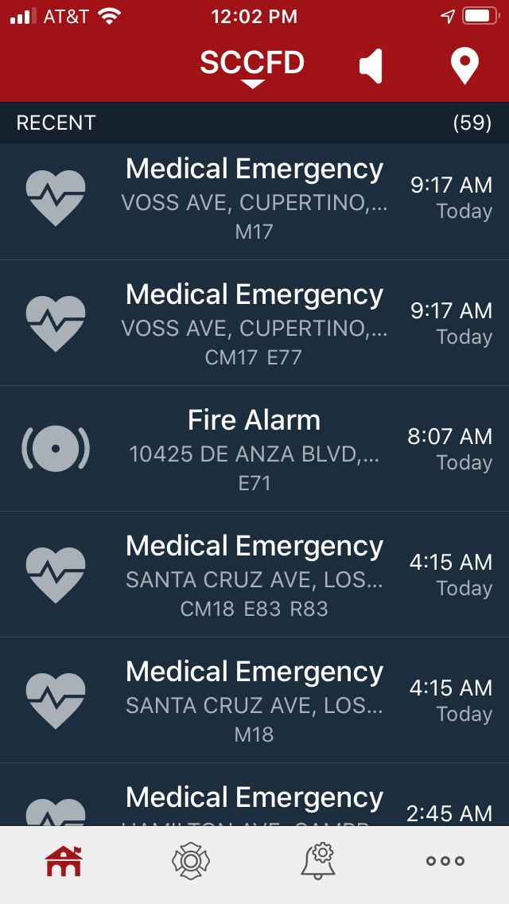
Not an emergency notification tool...
Download this app to follow local Fire Department
PulsePoint shows fire department activity
Can be reassuring to know what’s going on when you hear sirens
Tells you where/what the call for service is
Does not notify you of issues: sign up for AlertSCC!
And:
Shows AED machines nearby
You can sign up to receive alerts if someone near you needs CPR

Slide 7
Preparedness check-up: evacuation routes
Where ever you are... How will you get out?
When do I evacuate my home?
Local authorities advise evacuation
Red Flag warning (for fire)
Structure is on fire or approaching the structure
In a wildfire: go early, don’t wait!
Structure is structurally unsound or threatened by downed trees or power lines
When you feel unsafe
Two ways out!

Slide 8
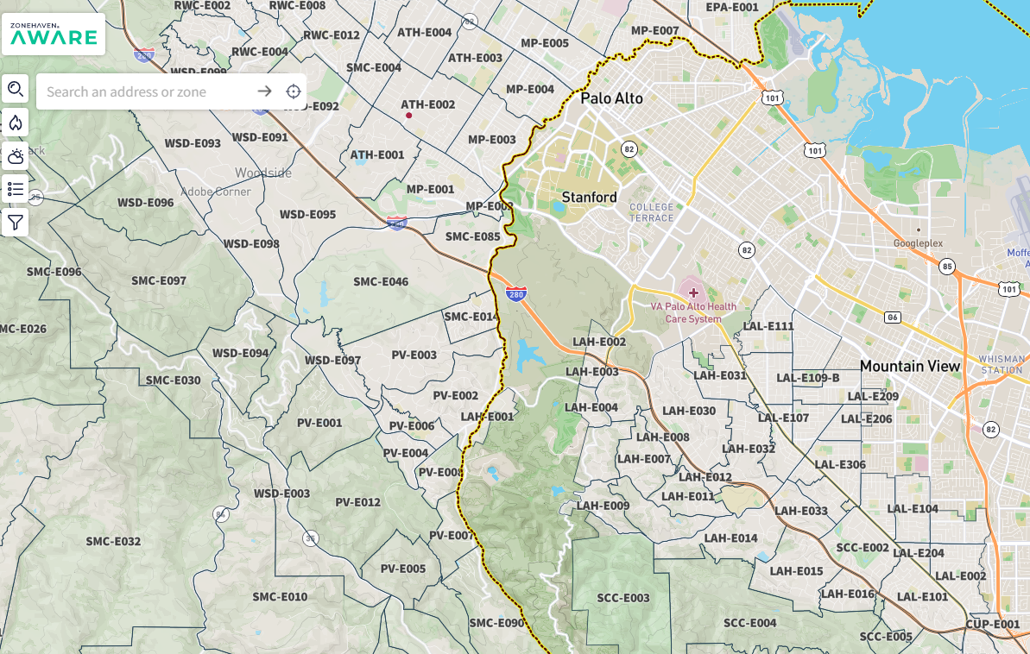
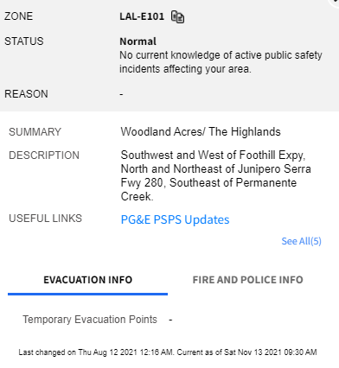
Zonehaven
Know your Zone
Check your Evacuation Routes
Register with AlertSCC
Los Altos Zones: LAL
Last 2 digits are the same as your “BAT Zone” e.g. Zone 1
Some “BAT Zones” are split into subzones, e.g. LAL-101 and LAL-201 with the first digit distinguishing them
Community.zonehaven.com
Check Current Status of your neighborhood

Slide 9
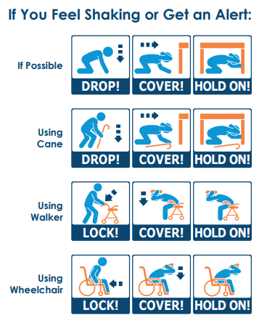
Earthquake Safety
In a quake:
Drop! Cover! Hold on!
Lock! Cover! Hold on!
After a quake:
Check yourself
Check your household
Help your neighbors

Slide 10
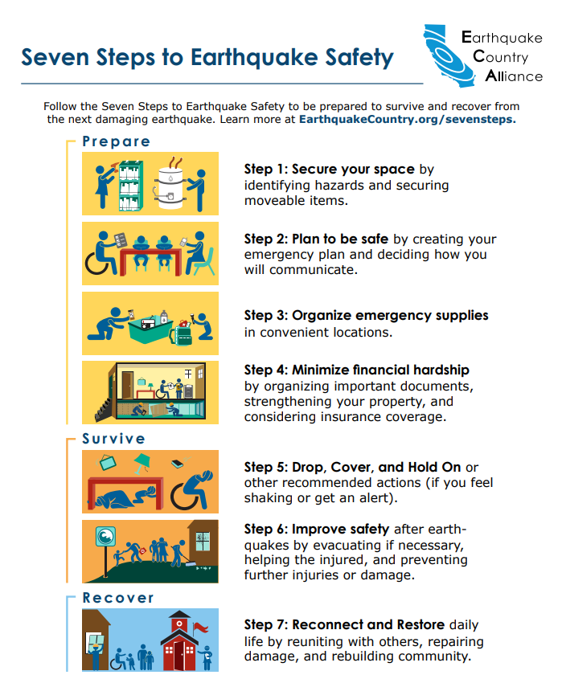
Earthquake Safety
Before a quake:
Take steps to mitigate your risk
7 Steps to Earthquake Safety
Seismic Retrofit: Earthquake Brace & Bolt Grant Program
Put a pair of sturdy shoes under your bed, along with a working flashlight
Download the MyShake early warning app
www.earthquakecountry.org/sevensteps/
www.earthquakebracebolt.com/

Slide 11
Preparedness check-up: Communications plan
Make a reunification plan
House fire... Area-wide disaster...
Where will we meet up?
How will we find each other?
Establish Out of Area Contacts
Telephone & cell phone service may be interrupted
Texting may not work
All household members need to have the same out-of-state contact
Learn how to change your outgoing voicemail message, and pick up voicemail messages without your cell phone
losaltosca.gov/communicationplan

Slide 12
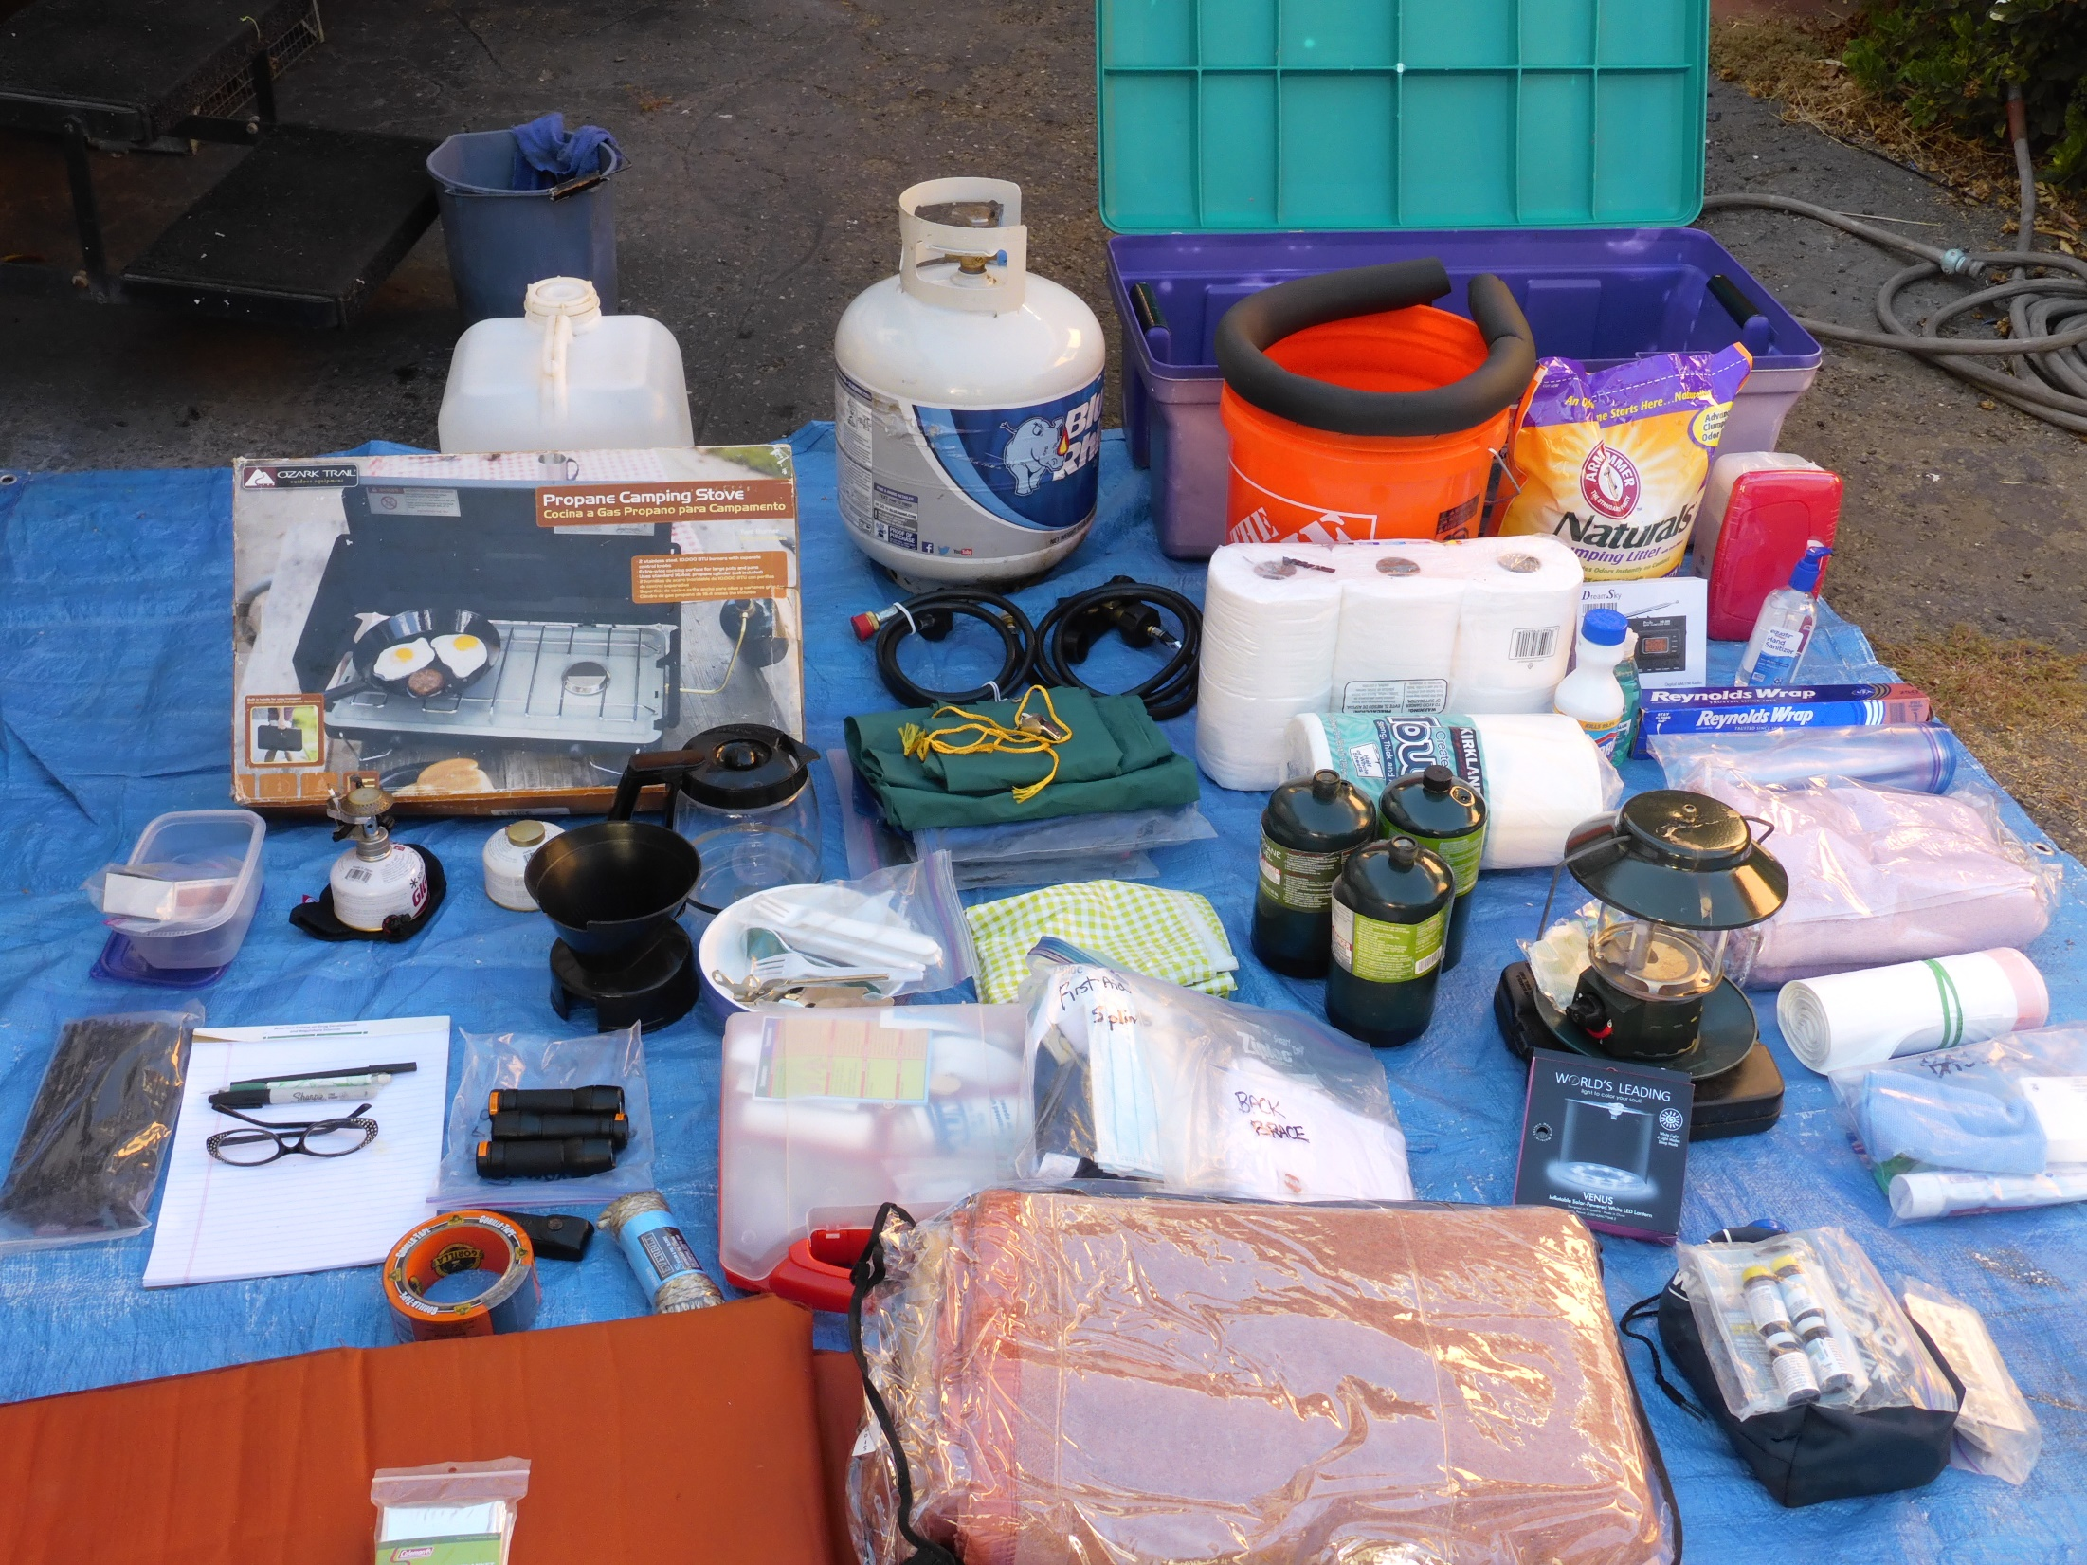
Emergency Preparedness Kits
If you don’t have one—make your emergency preparedness kits!
“WUSH” bag “Wake up, Something’s Happening”
Evacuation bag
Home emergency preparedness supplies
Vehicle Kit
Don’t forget your pets!
If you have one—check it!
Kits require maintenance
Food, water, batteries, medications need rotation to stay fresh
Other items may need to be replaced periodically
Family needs change! (Diapers... Tampons... Special foods...)
Kit storage: cool, dry, shaded, accessible, not in the way...
Examples and kit content lists:
losaltosca.gov/gobag
Notes:
(1 hour 40 minutes elapsed time)
Kit information Link-

Slide 13
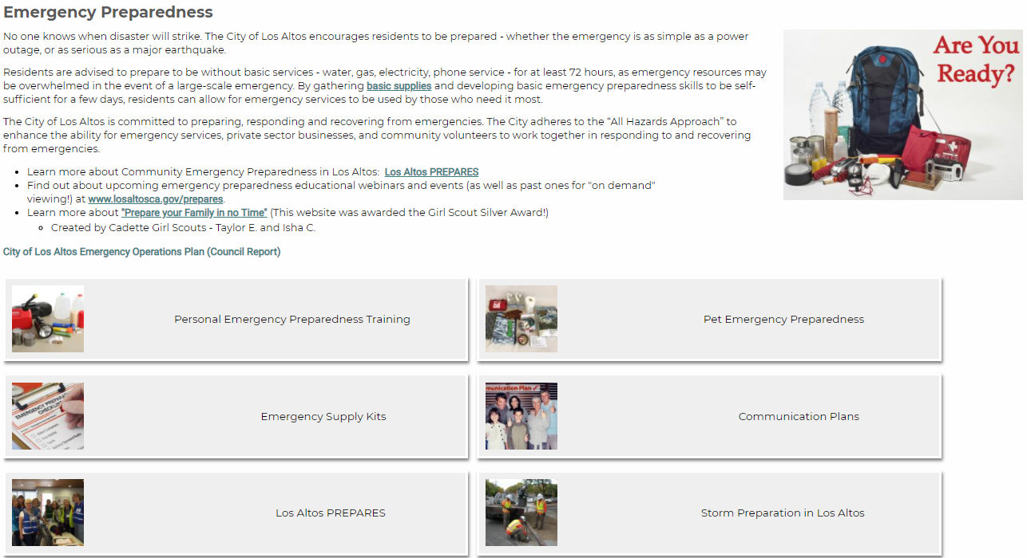
Learn More!
www.losaltosca.gov/emergencyprep
www.losaltosca.gov/prepares

Slide 14
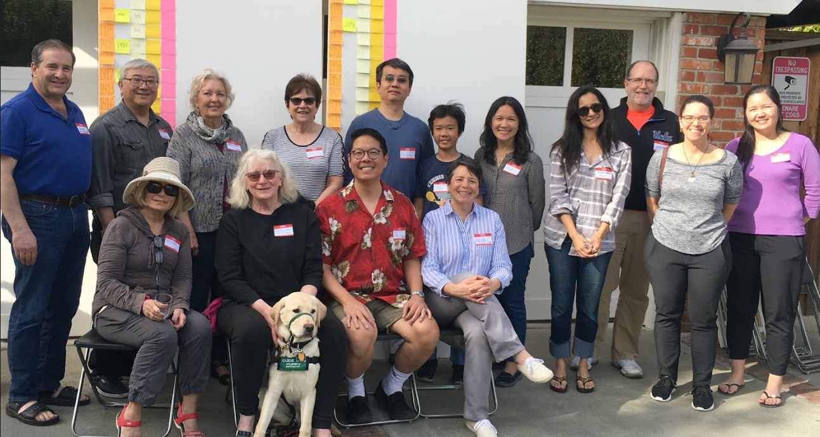
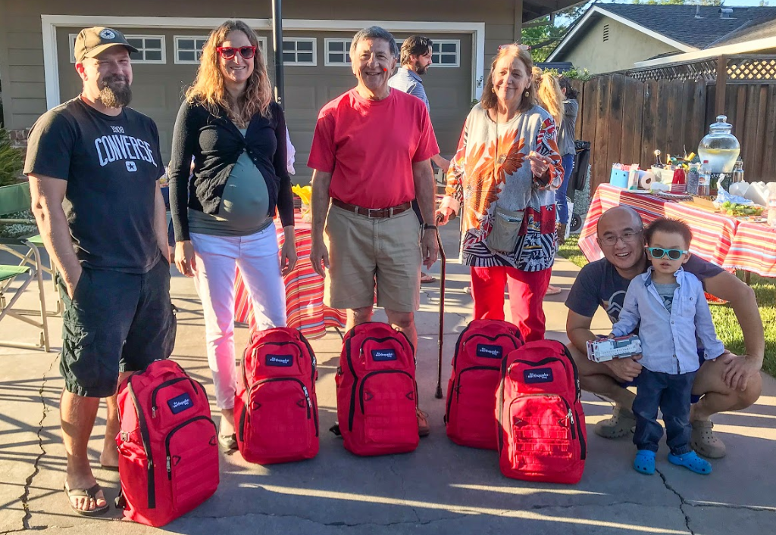
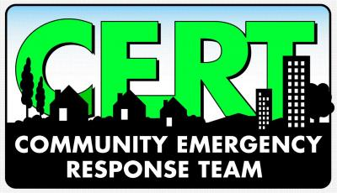
Community emergency preparedness
BAT –Block Action Team* leaders
*Block Action Team is a managed program of Los Altos Community Foundation
CERT – the Community Emergency Response Team
Los Altos and Los Altos Hills CERT programs invite you to get CERT-trained and to join our local teams!
Hams—amateur radio operators support community emergency communications
You’re invited to join Los Altos Amateur Radio Emergency Services www.laares.org or the Los Altos Hills program (contact the LAH Emergency Communications Commission)
Volunteers train to be ready to support the community’s emergency response:
assess the damage, help their neighbors, provide basic first aid and search and rescue, support emergency communications

Slide 15
Thank you!
AHEPENSTAL@LOSALTOSCA.GOV
www.losaltosca.gov/emergencyprep
www.losaltosca.gov/prepares

